Slide 1
控制谁？
Introduction to causal diagrams for confounder selection
Epidemiology Student Association at PUMC
真实世界研究系列讲座
孙殿钦
中国医学科学院肿瘤医院
2019-11-09

Slide 2
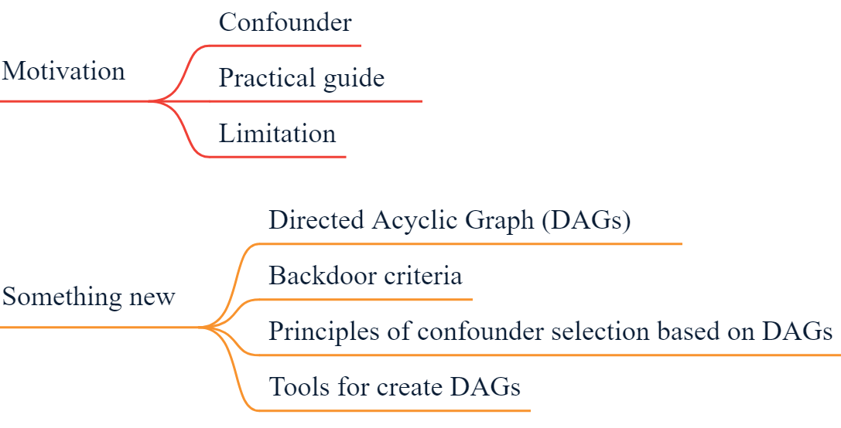
内容大纲

Slide 3

什么是混杂因素？
举个栗子？

Slide 4
什么是混杂因素?
混杂因素亦称外来因素、混杂因子或混杂变量，是指与研究因素和研究疾病均有关，若在比较的人群组中分布不均衡，可以歪曲（缩小或扩大）研究因素与疾病之间真实联系的因素。
混杂因素的基本特点是：
1是所研究疾病的危险因素
2与所研究的因素有关
3不是研究因素与研究疾病因果链上的中间变量
——《流行病学·第7版》

Slide 5
什么是混杂因素?
The developments in causal inference over the past two decades have made clear that this definition of a “confounder” is inadequate: there can be pre-exposure variables associated with the exposure and the outcome, the control of which introduces rather than eliminates bias (Greenland et al., 1999a; Glymour and Greenland, 2008; Pearl, 2009). The causal inference literature has moved away from formal language about “confounders” and instead places the conceptual emphasis on “confounding.” See Morabia (2011) for historical discussion of this point.
VanderWeele TJ, Shpitser I. On the definition of a confounder. Ann Stat. 2013;41(1):196–220.

Slide 6
什么是混杂因素?
We propose that a “confounder” be defined as a pre-exposure covariate C for which there exists a set of other covariates X such that effect of the exposure on the outcome is unconfounded conditional on (X, C) but such that for no proper subset of (X, C) is the effect of the exposure on the outcome unconfounded given the subset.
VanderWeele TJ, Shpitser I. On the definition of a confounder. Ann Stat. 2013;41(1):196–220.

Slide 7
什么是混杂因素?
混杂因素的定义并不重要，重要的是我们要控制谁？

Slide 8

如何筛选混杂因素?
纳入多元模型
的混杂因素
样本量

Slide 9
如何筛选混杂因素?
临床相关性
单因素分析
是否会引起效应值较大变化
向前/后选择（forward/backward selection）

Slide 10
实际操作中的局限性
无法直观考虑变量间错综复杂的关系
可能会错误调整中介变量
并不是所有的混杂都需要调整
如何让审稿人信服？怎么证明你有理有据，没有P-hacking？

Slide 11
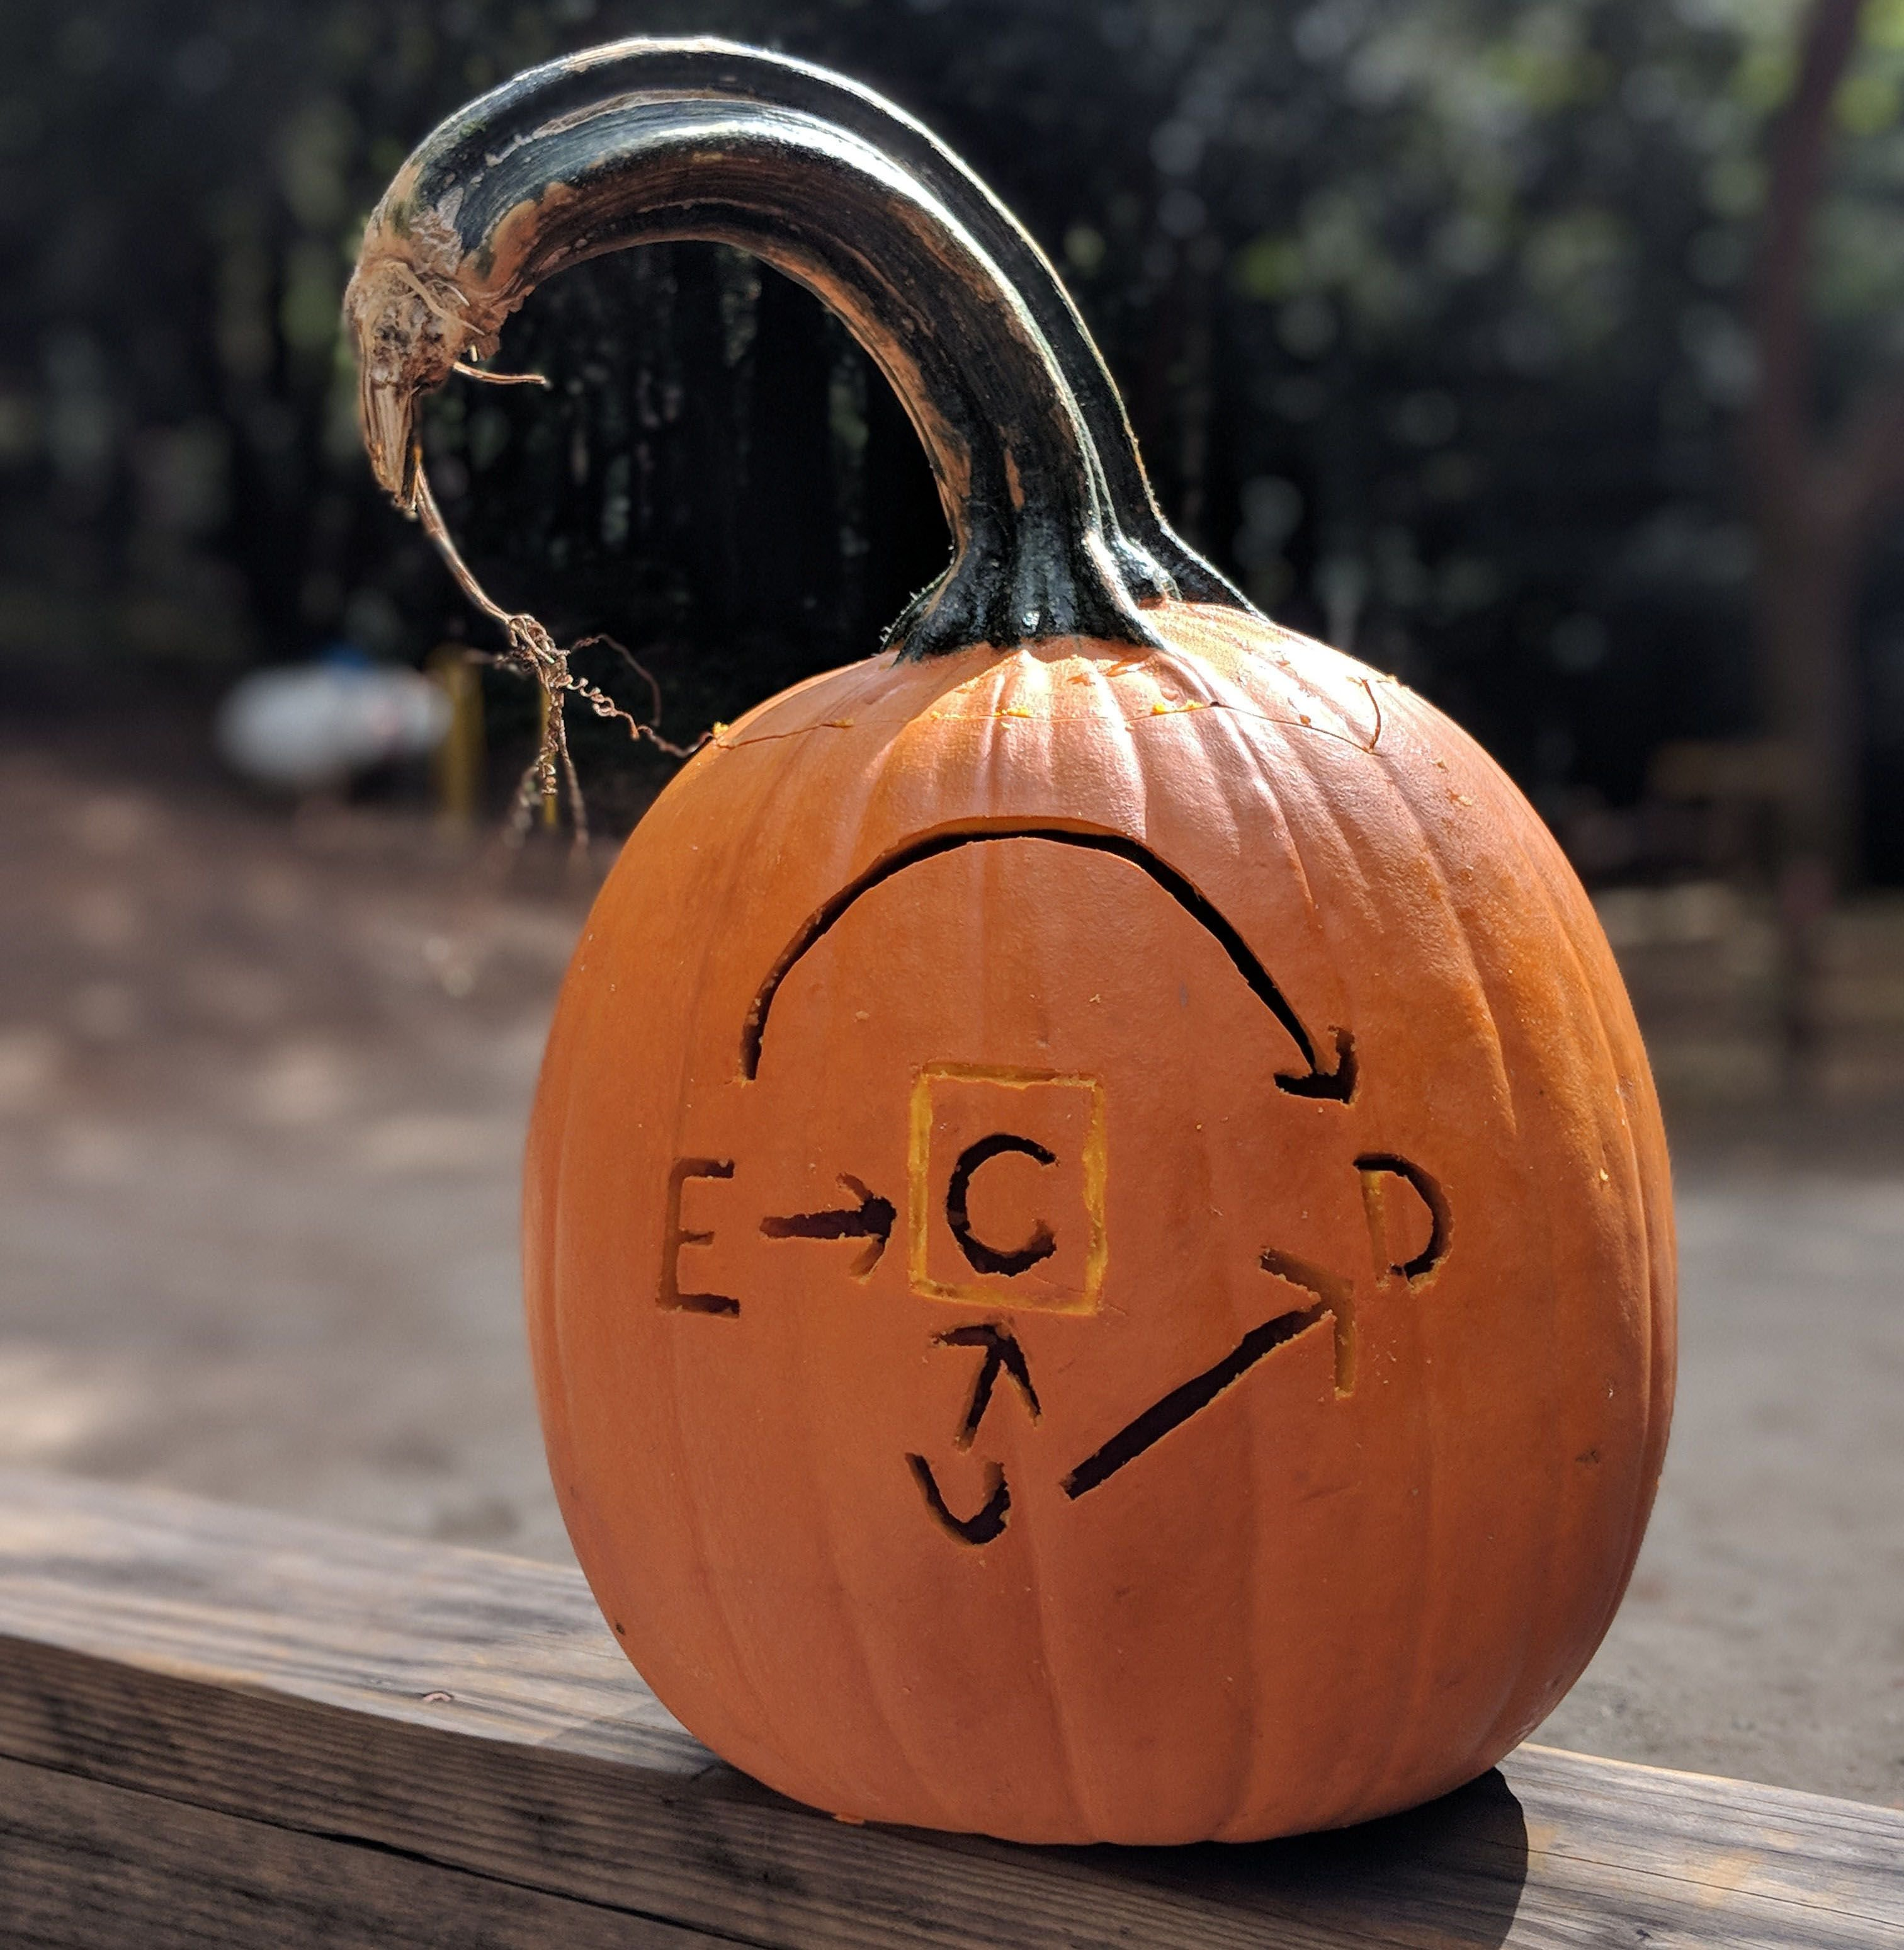
有向无环图Directed Acyclic Graph

Slide 12
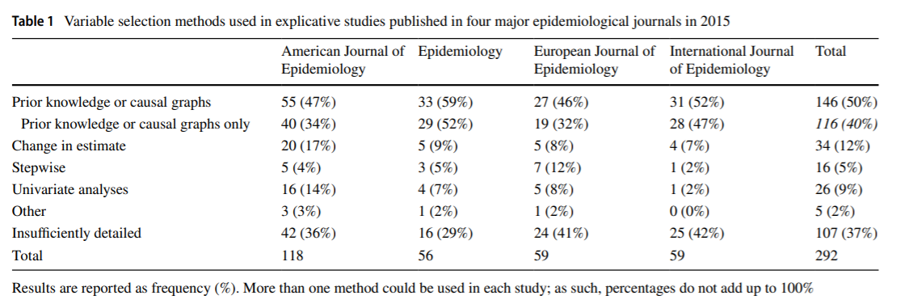
Current situation
Talbot, D. & Massamba, V.K. A descriptive review of variable selection methods in four epidemiologic journals: there is still room for improvement. Eur J Epidemiol (2019) 34: 725. https://doi.org/10.1007/s10654-019-00529-y

Slide 13
举个栗子
上世纪70年代，流行病学家发现服用雌激素的女性宫颈癌确诊率较高。
对此现象，有两个可能的解释：
雌激素导致了宫颈癌的发生
雌激素增加了子宫流血的风险，而宫颈癌也会导致子宫流血，促使了宫颈癌的发现和诊断

Slide 14
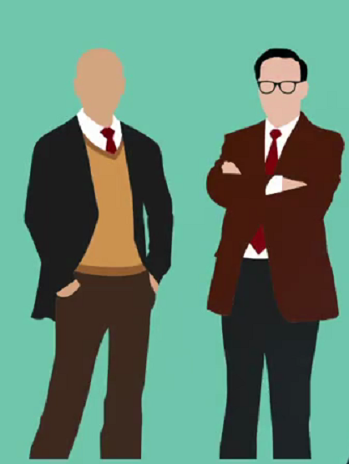
举个栗子
两位来自Yale的研究者提出根据是否出现子宫流血进行分层分析。

Slide 15

举个栗子
来自波士顿和哈佛的研究者表达了反对意见，没有必要控制子宫是否出现流血这一变量。

Slide 16
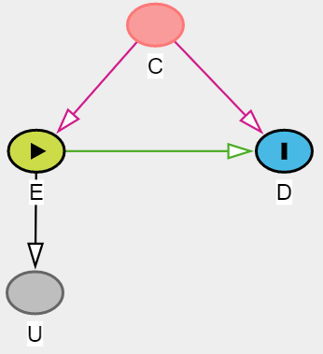
有向无环图Directed Acyclic Graph
Balls represent variables (nodes)
Links represent associations
Arrows represent causal relationships
Path
Directed paths are denoted by arrowed links
Acylic: No loops, the future does not cause the past

Slide 17
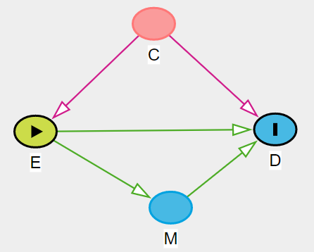
有向无环图Directed Acyclic Graph
Encoded assumptions
Absence of variables: all common (observed and unobserved) causes of any pair of variables
Absence of arrows: zero causal effect

Slide 18
有向无环图Directed Acyclic Graph
Frontdoor paths: A path in which all arrows point away from the exposure, E, to the outcome, D
前门路径：从暴露出发到结局，路径方向完全顺着该路径上变量间的箭头方向
Backdoor paths: A path connecting E and D in which at least one arrow points against the flow of time
后门路径：从暴露出发到结局，路径方向与路径上变量间箭头方向不完全一致

Slide 19
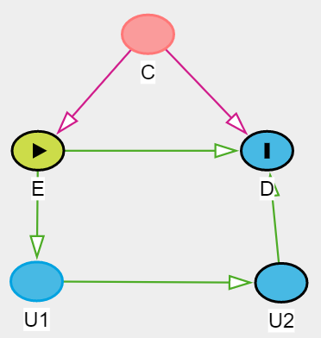
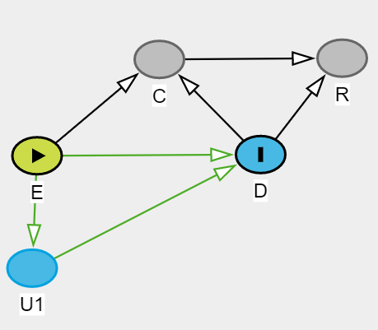
Frontdoor/Backdoor paths ·Practice
Frontdoor paths & Backdoor paths

Slide 20
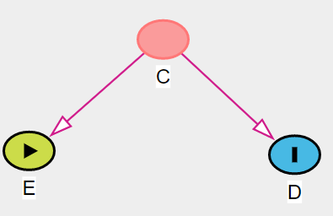
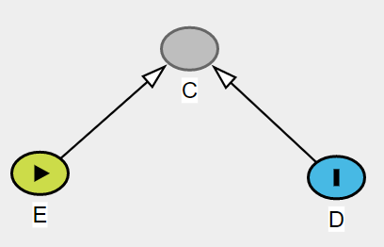
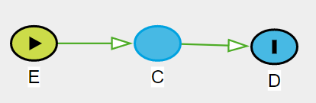
DAG·Elementary DAG
Common cause (confounder)
Common effect (collider)
Causal chain (mediator)

Slide 21
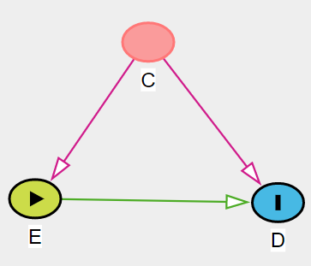
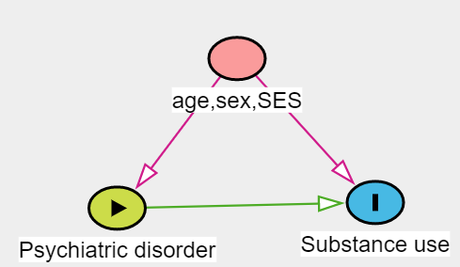
DAG·Confounder
Common cause
Adjust?
Adjust!
Mangerud, W.L., Bjerkeset, O., Holmen, T.L., Lydersen, S., & Indredavik, M.S. 2014. Smoking, alcohol consumption, and drug use among adolescents with psychiatric disorders compared with a population based sample. Journal of Adolescence, 37, (7) 1189-1199

Slide 22

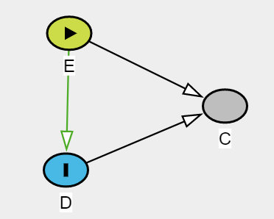
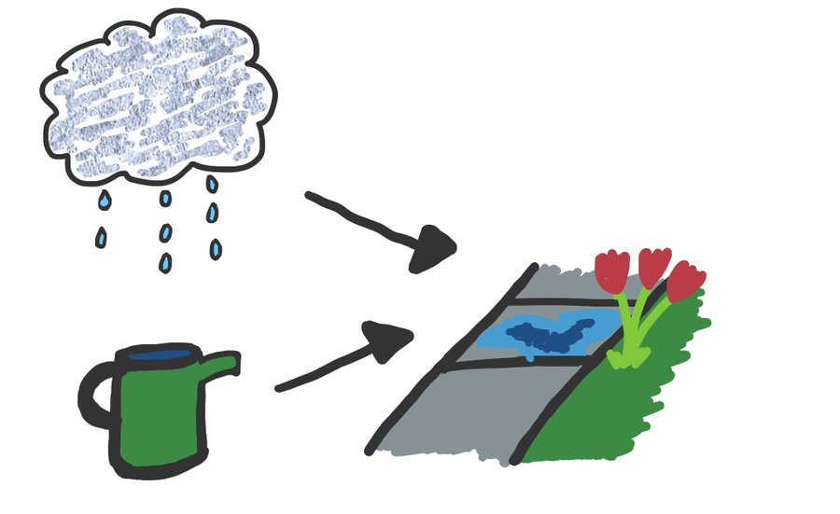

DAG·Collider
Adjust?
Not adjust!
长得好
Common effect
出名
演得好

Slide 23
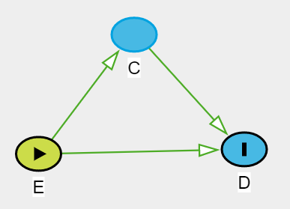
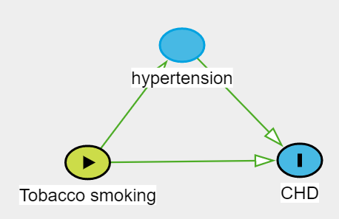
DAG·Mediator
Adjust?
Depend on ur Question!

Slide 24
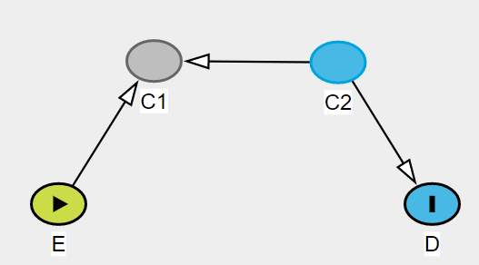
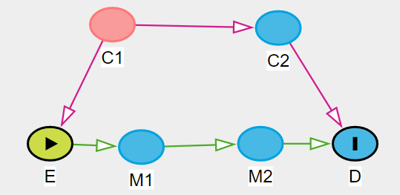
Graphical identification criteria
“Unblocked” paths & “Blocked” paths
关闭路径（路径上存在碰撞变量）：碰撞变量两侧的变量之间无条件独立。
开放路径（路径上不存在碰撞变量）：该路径上的变量之间存在关联。

Slide 25
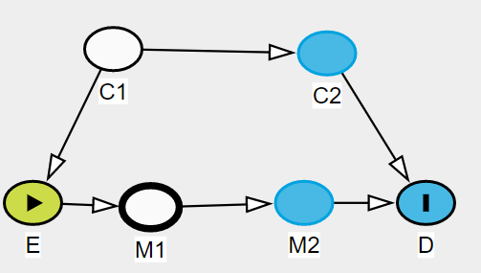
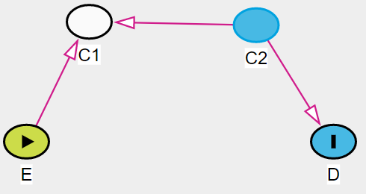
Graphical identification criteria
“Unblocked” paths & “Blocked” paths
Three blocking criteria (key!!)
1. Conditioning on a non-collider blocks a path 控制非碰撞变量会关闭路径
2. Conditioning on a collider, or a descendent of a collider, unblocks a path控制碰撞变量或者碰撞变量子变量，会打开路径
3. Not conditioning on a collider leaves a path “naturally” blocked.
不控制路径中的碰撞变量，该路径就是自然关闭的

Slide 26
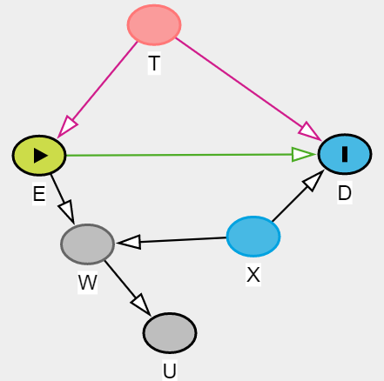
Graphical identification criteria Backdoor criterion
Backdoor criteria: We need to block all backdoor paths between E and D.
（后门准则：关闭所有开放的后门路径即可充分控制混杂）
T, (X,T),(W,X,T),(U,X,T),(W,U,X,T)

Slide 27
Backdoor criterion·Practice

Slide 28
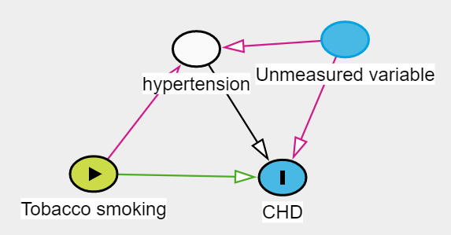
DAG·Mediator
Adjust?
Ananth C V , Schisterman E F . Confounding, Causality and Confusion: The Role of Intermediate Variables in Interpreting Observational Studies in Obstetrics[J]. American Journal of Obstetrics and Gynecology, 2017:S0002937817305173.

Slide 29
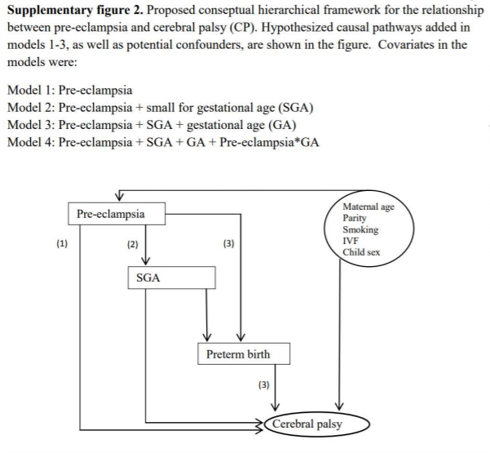
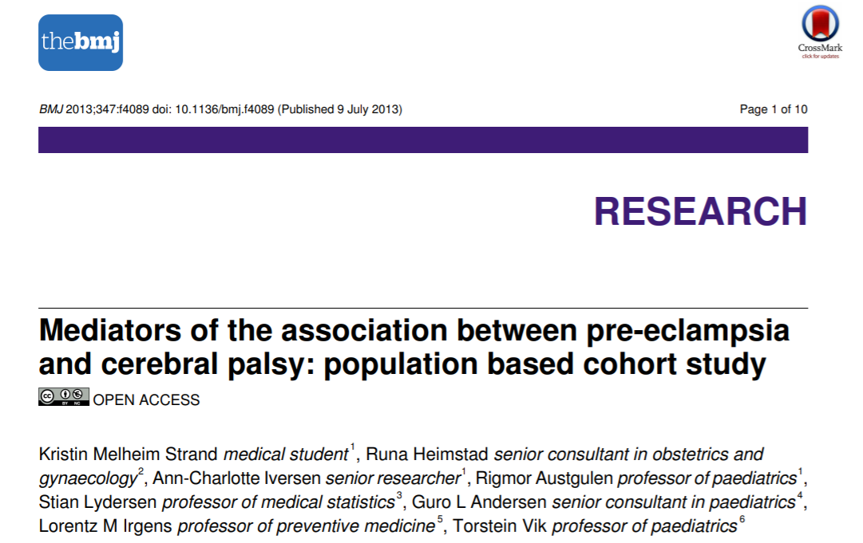
DAG·Mediator
子痫前期→早产/低出生体重→新生儿脑性麻痹
Strand K M , Heimstad R , Iversen A C , et al. Mediators of the association between pre-eclampsia and cerebral palsy: population based cohort study[J]. BMJ, 2013, 347(jul09 2):f4089-f4089.

Slide 30
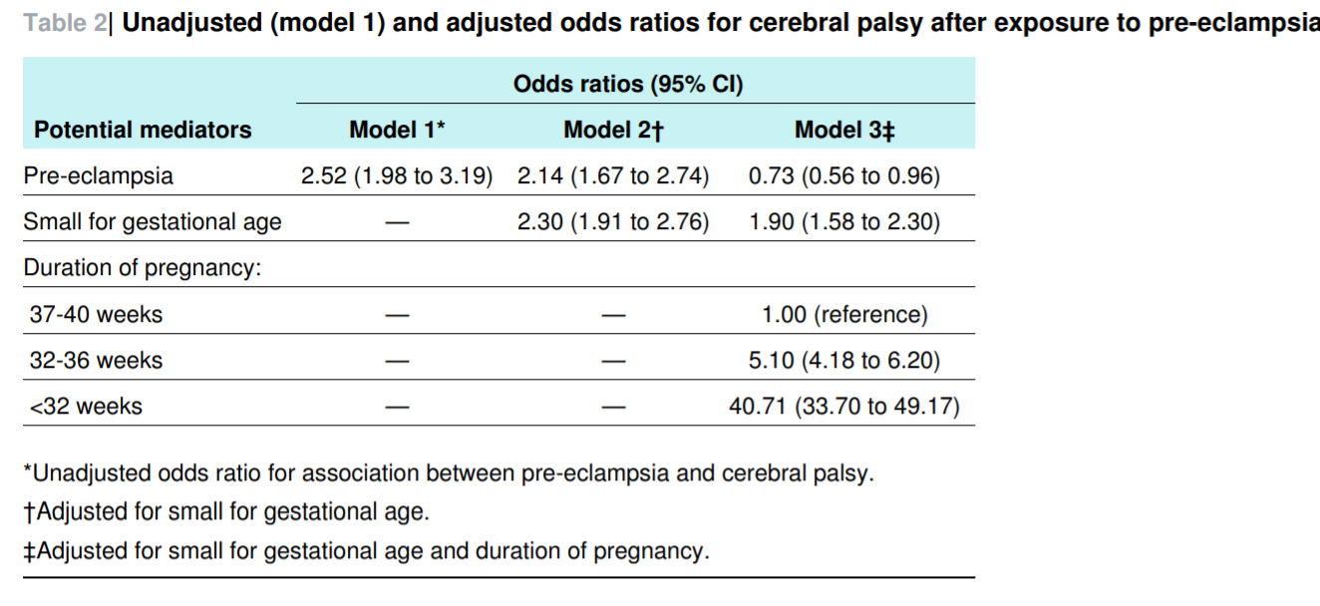
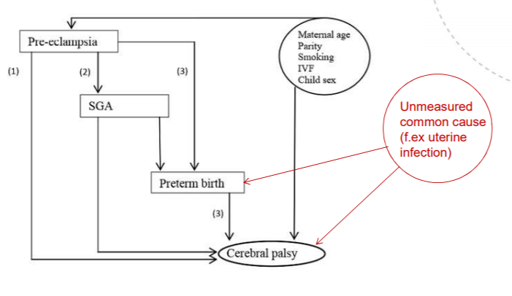
DAG·Mediator
子痫前期→早产/低出生体重→新生儿脑性麻痹
“母亲发生子痫前期与新生儿脑性麻痹的风险增加有关，并且主要是通过早产介导的，也可由低出生体重介导。在母亲发生子痫前期的新生儿中，出生体重正常的足月儿无发生脑性麻痹的额外风险。”
Strand K M , Heimstad R , Iversen A C , et al. Mediators of the association between pre-eclampsia and cerebral palsy: population based cohort study[J]. BMJ, 2013, 347(jul09 2):f4089-f4089.

Slide 31
举个栗子
上世纪70年代，流行病学家发现服用雌激素的女性宫颈癌确诊率较高。
对此现象，有两个可能的解释：
雌激素导致了宫颈癌的发生
雌激素增加了子宫流血的风险，而宫颈癌也会导致子宫流血，促使了宫颈癌的发现和诊断

Slide 32
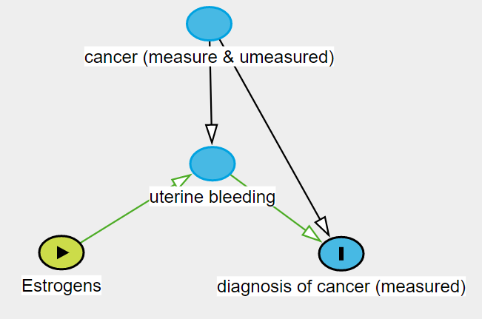
DAG·Collider bias
观察到的使用雌激素与被诊断子宫颈癌有关，有以下两种路径
A雌激素导致宫颈癌发生（真实因果）
B 雌激素导致子宫出血，子宫出血促使了宫颈癌的诊断（检出症候偏倚）
C
A
A
C
C
B
B
如果控制了子宫是否出血这一变量，可以阻断路径B，但又开放了路径C

Slide 33
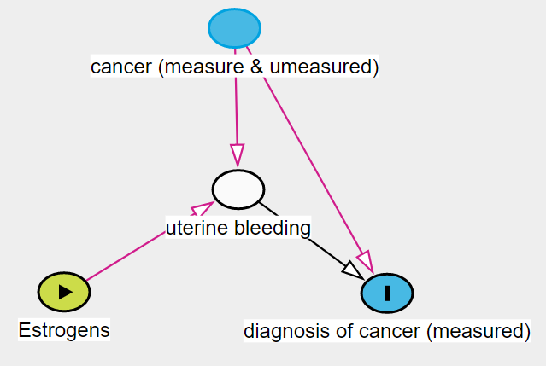
DAG·Collider bias
如何证实使用雌激素导致被诊断为子宫颈癌的机会增高
是因为
使用雌激素导致了子宫颈癌发病呢？ （如何避免检出症候偏倚？）

Slide 34
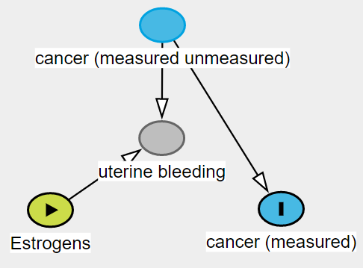
DAG·Collider bias

Slide 35
If the DAG is Not Fully Known

Slide 36
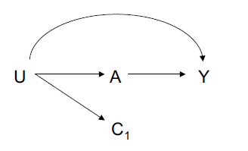
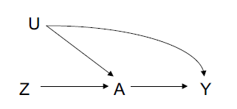
Principles of confounder selection
Control for each covariate that is a cause of the exposure, or of the outcome, or of both;控制暴露或者结局或者二者共同的cause
Exclude from this set any variable known to be an instrumental variable; 不要控制工具变量
Include as a covariate any proxy for an unmeasured variable that is a common cause of both the exposure and the outcome.有未观测的混杂时，可以控制它的子变量
VanderWeele, T.J. Principles of confounder selection.Eur J Epidemiol (2019) 34: 211. https://doi.org/10.1007/s10654-019-00494-6

Slide 37
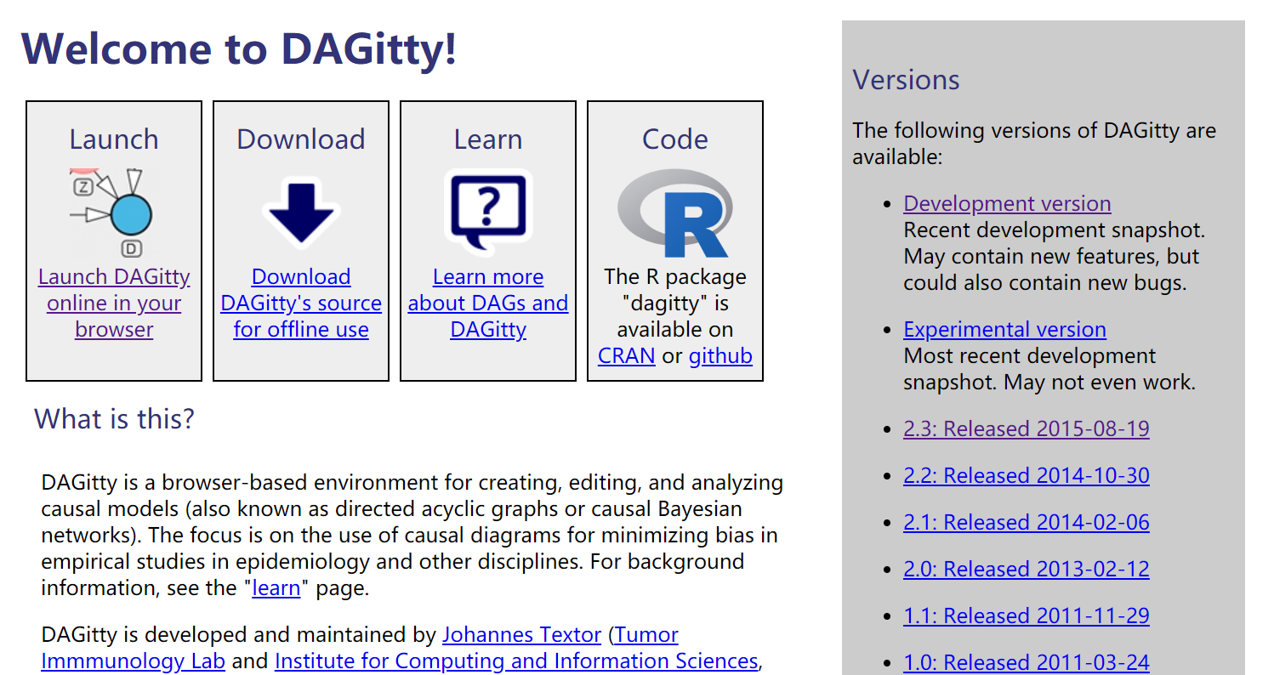
Create DAGs·Tools
http://dagitty.net/
Textor, J., Hardt, J., Knuppel, S., 2011. DAGitty: a graphical tool for analyzing causal diagrams. Epidemiology 22, 745. https://doi.org/10.1097/EDE.0b013e318225c2be.

Slide 38

DAGs的其他应用
指导缺失数据的处理
Margarita Moreno-Betancur, Katherine J Lee, Finbarr P Leacy, Ian R White, Julie A Simpson, John B Carlin, Canonical Causal Diagrams to Guide the Treatment of Missing Data in Epidemiologic Studies, American Journal of Epidemiology, Volume 187, Issue 12, December 2018, Pages 2705–2715, https://doi.org/10.1093/aje/kwy173
Notes:
DAGs在流行病学研究中还可以有很多用途。比如指导缺失数据的处理。

Slide 39
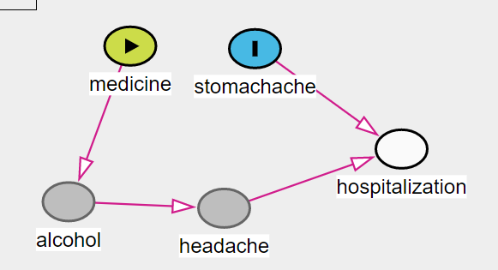
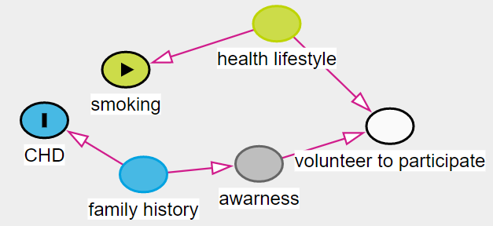
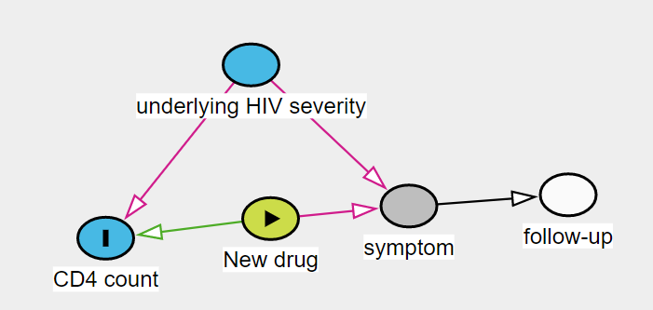
DAGs的其他应用
辅助教学：偏倚的理解
Berkson’s Bias
Volunteer Bias
Differential Loss to Follow Up
Hernán, Miguel A, Hernández-Díaz, Sonia, Robins J M . A Structural Approach to Selection Bias[J]. Epidemiology, 2004, 15(5):615-625.

Slide 40
参考文献
https://www.edx.org/course/causal-diagrams-draw-your-assumptions-before-your-conclusions-2
https://www.coursera.org/learn/crash-course-in-causality#syllabus
向韧, 戴文杰, 熊元, et al. 有向无环图在因果推断控制混杂因素中的应用[J]. 中华流行病学杂志, 2016, 6(7):107-108.
郑英杰, 赵耐青. 有向无环图：语言、规则及应用[J]. 中华流行病学杂志, 2017, 38(08):1140-1144.
刘子言, 吴小丽, 解美秋, et al. 在因果推断中应用有向无环图识别和控制选择偏倚[J]. 中华疾病控制杂志, 2019(3).
Strand K M , Heimstad R , Iversen A C , et al. Mediators of the association between pre-eclampsia and cerebral palsy: population based cohort study[J]. BMJ, 2013, 347(jul09 2):f4089-f4089.
Cole SR, Platt RW, Schisterman EF, et al. Illustrating bias due to conditioning on a collider. Int J Epidemiol. 2010;39(2):417–420. doi:10.1093/ije/dyp334
VanderWeele, T.J. Eur J Epidemiol (2019) 34: 211. https://doi.org/10.1007/s10654-019-00494-6

Slide 41
参考文献
Strand K M , Heimstad R , Iversen A C , et al. Mediators of the association between pre-eclampsia and cerebral palsy: population based cohort study[J]. BMJ, 2013, 347(jul09 2):f4089-f4089.
Karl DF, Mark MC, Srinivasa VK, et al. Evidence synthesis for constructing directed acyclic graphs (ESC-DAGs): a novel and systematic method for building directed acyclic graphs, International Journal of Epidemiology, 2019, dyz150, https://doi.org/10.1093/ije/dyz150
Textor, J., Hardt, J., Knuppel, S., 2011. DAGitty: a graphical tool for analyzing causal diagrams. Epidemiology 22, 745. https://doi.org/10.1097/EDE.0b013e318225c2be
Talbot, D. & Massamba, V.K. A descriptive review of variable selection methods in four epidemiologic journals: there is still room for improvement. Eur J Epidemiol (2019) 34: 725. https://doi.org/10.1007/s10654-019-00529-y
Margarita Moreno-Betancur, Katherine J Lee, Finbarr P Leacy, Ian R White, Julie A Simpson, John B Carlin, Canonical Causal Diagrams to Guide the Treatment of Missing Data in Epidemiologic Studies, American Journal of Epidemiology, Volume 187, Issue 12, December 2018, Pages 2705–2715, https://doi.org/10.1093/aje/kwy173
Hernán, Miguel A, Hernández-Díaz, Sonia, Robins J M . A Structural Approach to Selection Bias[J]. Epidemiology, 2004, 15(5):615-625.

Slide 42

Thanks！

Slide 44
Directed Acyclic Graph·Key player
Computer Science: Judea Pearl, Jin Tian, Thomas Verma
Philosophy: Peter Spirtes, Clark Glymour, Richard Scheines
Biostatistics: Jamie Robins, Sander Greenland, Tyler VanderWeele, Miguel Hernan

Slide 45
Create DAGs·Method
Mapping Translation Integration 1:synthesis Integration 2: recombination
To produce a DAG that corresponds to the conclusions of the study under review (accurate or otherwise) and is ‘saturated’ with an edge between all pairs of nodes.
1. Outcome variable of interest is set as DAG outcome(s).
2. Exposure variable(s) of interest is set as DAG exposure(s).
3. A directed edge is drawn originating from the exposure(s), terminating at the outcome(s).
4. All control variables are entered as unassigned variables.
5. A directed edge is drawn originating from each control to the exposure(s) and outcome(s).
6. Mediators, instrumental variables etc. are mapped as per the study’s conclusions.
7. The ‘implied graph’ is saturated by drawing directed or undirected edges between all confounders (direction does not matter until the translation stage). The recombination process can be performed at this stage to help simplify an overly complex IG.
Karl DF, Mark MC, Srinivasa VK, et al. Evidence synthesis for constructing directed acyclic graphs (ESC-DAGs): a novel and systematic method for building directed acyclic graphs, International Journal of Epidemiology, 2019, dyz150, https://doi.org/10.1093/ije/dyz150

Slide 46
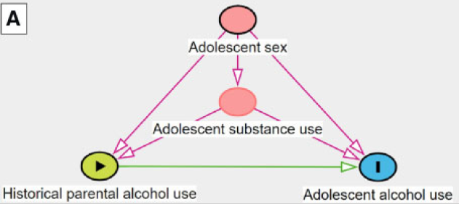
Create DAGs·Method
Mapping Translation Integration 1:synthesis Integration 2: recombination
Implied graph for hypothetical study
Karl DF, Mark MC, Srinivasa VK, et al. Evidence synthesis for constructing directed acyclic graphs (ESC-DAGs): a novel and systematic method for building directed acyclic graphs, International Journal of Epidemiology, 2019, dyz150, https://doi.org/10.1093/ije/dyz150

Slide 47
Create DAGs·Method
Mapping Translation Integration 1:synthesis Integration 2: recombination
Each relationship in the IG is assessed under sequential causal criteria and a counterfactual thought experiment
Temporality—does the posited cause precede effect? (If ‘yes’, proceed to next criterion. If not, assess reverse relationship.)
Face-validity—is the posited relationship plausible? (If ‘yes’, proceed to next criterion. If not, assess reverse relationship.)
Recourse to theory—is the posited relationship supported by theory? (Always proceed to the counterfactual thought experiment.)
Counterfactual thought experiment—is the posited relationship supported by a systematic thought experiment informed by the POF? (Once completed, always assess the reverse relationship unless already assessed.)
Karl DF, Mark MC, Srinivasa VK, et al. Evidence synthesis for constructing directed acyclic graphs (ESC-DAGs): a novel and systematic method for building directed acyclic graphs, International Journal of Epidemiology, 2019, dyz150, https://doi.org/10.1093/ije/dyz150

Slide 48
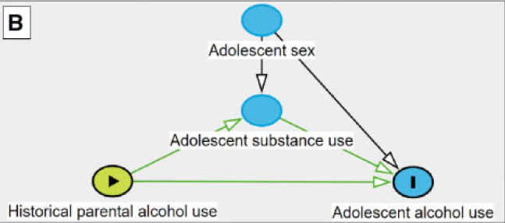
Create DAGs·Method
Mapping Translation Integration 1:synthesis Integration 2: recombination
Implied graph for hypothetical study
DAG for hypothetical study
Karl DF, Mark MC, Srinivasa VK, et al. Evidence synthesis for constructing directed acyclic graphs (ESC-DAGs): a novel and systematic method for building directed acyclic graphs, International Journal of Epidemiology, 2019, dyz150, https://doi.org/10.1093/ije/dyz150

Slide 49
Create DAGs·Method
Mapping Translation Integration 1:synthesis Integration 2: recombination
A new DAG is created to serve as the integrated DAG (I-DAG).
The focal relationship is added to the I-DAG (as per mapping steps 1–3).
Each indexed directed edge pertaining to the focal relationship (including its corresponding node) is added to the diagram.
Each indexed directed edge pertaining to other nodes is added (e.g. between confounders).
Conceptually similar nodes should be grouped together in virtual space to aid the recombination process.
Karl DF, Mark MC, Srinivasa VK, et al. Evidence synthesis for constructing directed acyclic graphs (ESC-DAGs): a novel and systematic method for building directed acyclic graphs, International Journal of Epidemiology, 2019, dyz150, https://doi.org/10.1093/ije/dyz150

Slide 50
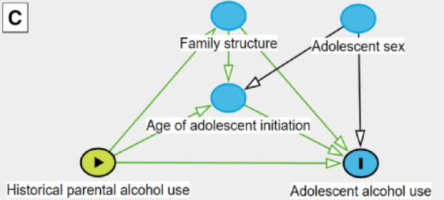
Create DAGs·Method
Mapping Translation Integration 1:synthesis Integration 2: recombination
DAG for the study by Seljamo et al
Karl DF, Mark MC, Srinivasa VK, et al. Evidence synthesis for constructing directed acyclic graphs (ESC-DAGs): a novel and systematic method for building directed acyclic graphs, International Journal of Epidemiology, 2019, dyz150, https://doi.org/10.1093/ije/dyz150

Slide 51
Create DAGs·Method
Mapping Translation Integration 1:synthesis Integration 2: recombination
To combine nodes for either practical reasons (i.e. to reduce complexity) or substantive reasons (i.e. to establish consistency).
Is there theoretical support for combining two variables/nodes?
Do the conceptually related nodes have similar inputs and outputs (i.e. do they ‘send to’ and ‘receive from’ the same nodes)?
Karl DF, Mark MC, Srinivasa VK, et al. Evidence synthesis for constructing directed acyclic graphs (ESC-DAGs): a novel and systematic method for building directed acyclic graphs, International Journal of Epidemiology, 2019, dyz150, https://doi.org/10.1093/ije/dyz150

Slide 52
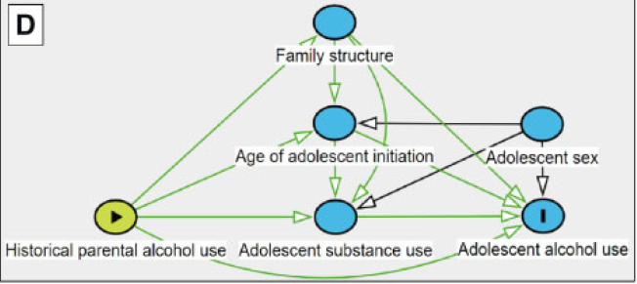
Create DAGs·Method
Mapping Translation Integration 1:synthesis Integration 2: recombination
DAG for hypothetical study
Integratd DAG for hypothetical study and the study by Seljamo et al
DAG for the study by Seljamo et al
Karl DF, Mark MC, Srinivasa VK, et al. Evidence synthesis for constructing directed acyclic graphs (ESC-DAGs): a novel and systematic method for building directed acyclic graphs, International Journal of Epidemiology, 2019, dyz150, https://doi.org/10.1093/ije/dyz150

Slide 53
Effect modification or Interaction
VanderWeele, Tyler J . On the Distinction Between Interaction and Effect Modification[J]. Epidemiology, 2009, 20(6):863-871.
Weinberg, Clarice R . Can DAGs Clarify Effect Modification?[J]. Epidemiology, 2007, 18(5):569-572.
Tyler VanderWeele;James Robins. Four Types of Effect Modification: A Classification Based on Directed Acyclic Graphs. Epidemiology, 200718(5):561-568.

